Slide 1
EE 175B
Free Space Optical
Communication System
Uriel Escobar
Caroline Le
Ikenna Nkwocha
Winter Quarter
Project Report

Slide 2
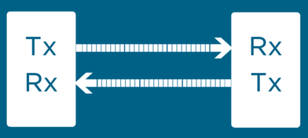
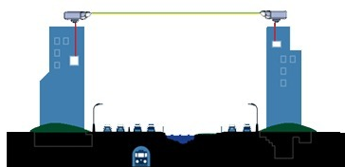
Concept of FSO Communications
We created a communication system that wirelessly sends information from one transceiver to another using a laser source and photodiode mounted on respective calibration systems.
Technical Principles:
Circuit Design
Embedded Systems
Signal Analysis/Theory

Slide 3
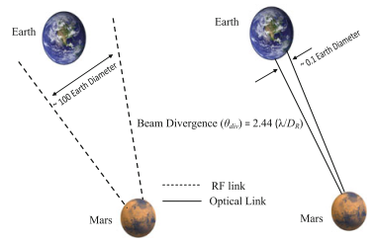
Why Free Space Optics?
The demand for wireless communications continue to rise
Using FSO does not require government permission or licensure
Extremely high data speeds can be achieved at much lower costs compared to RF
Less invasive alternative to fiber optics
Comparison of RF and optical beam divergence from Mars towards Earth

Slide 4
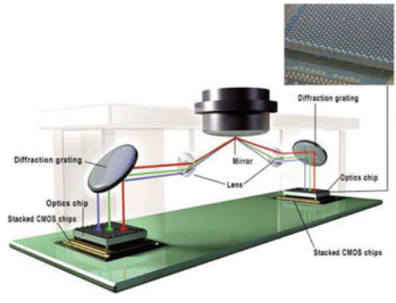
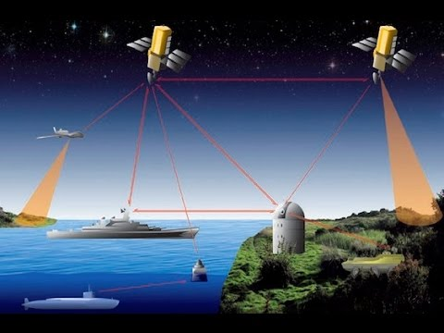
Applications of FSO
Communication systems where wired alternatives are not possible
Indoor communication systems that allow flexible interconnection within a building
FSO interconnects used in chip-to-chip or board-to-board interconnections.

Slide 5
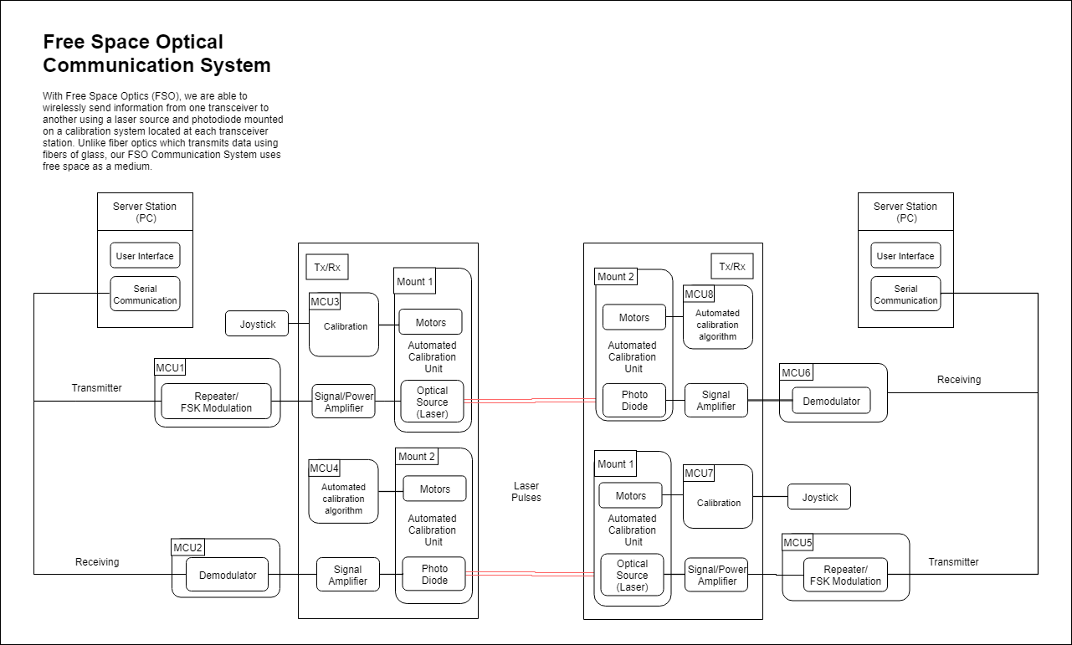

Slide 6
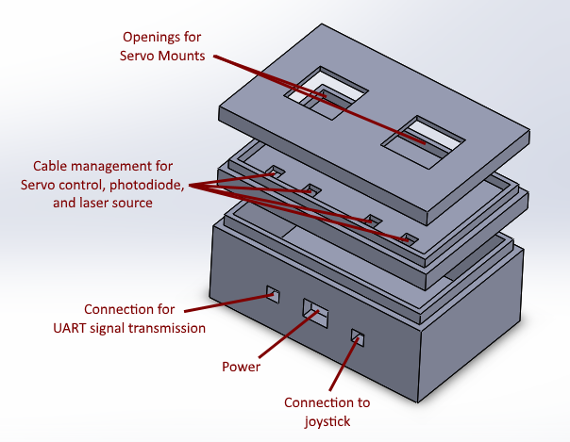
Technical Design Objectives
Transmit a laser signal at a distance of one meter with a baud rate of 9600
Keep voltage requirement at 5V to 6V
Automated calibration
Portable size
Housing for Free Space Communication System

Slide 7
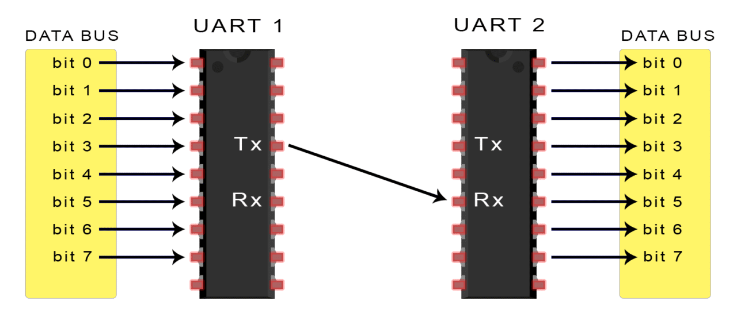
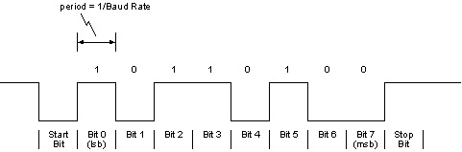
Serial Communication
UART - Universal Asynchronous Receiver/Transmitter

Slide 8
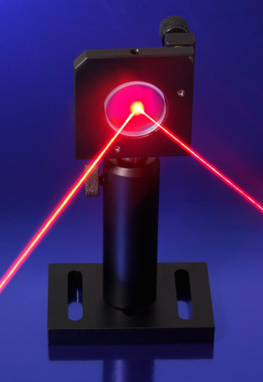
Transmitter Optical Source
LASER: Light amplification by stimulated emission of radiation
Monochromatic
Low beam divergence
Fast
High power

Slide 9
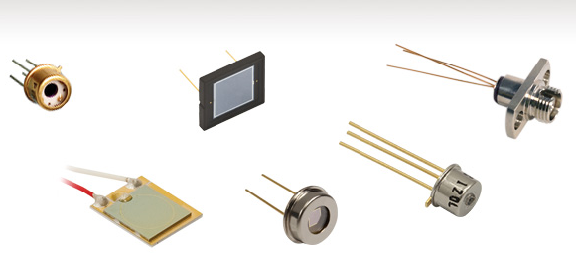
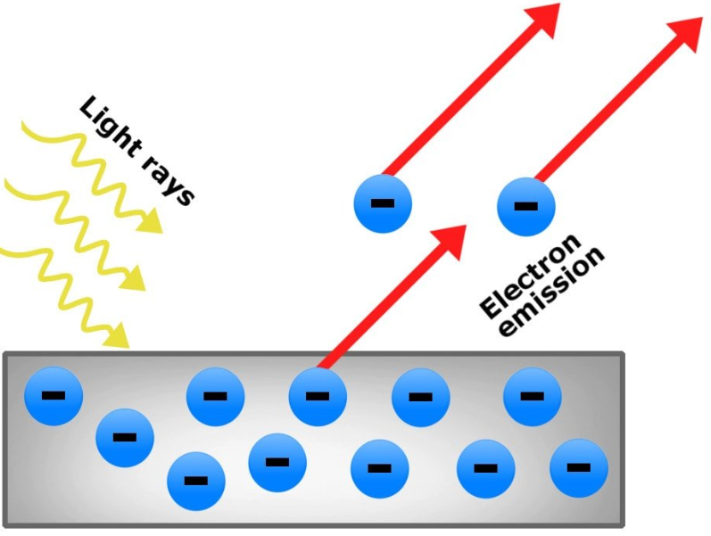
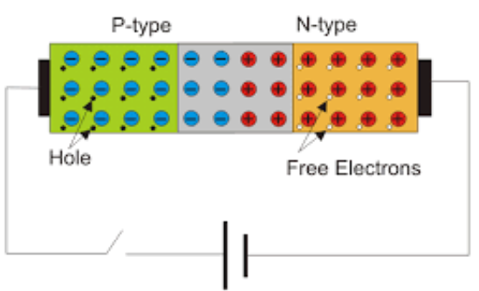
Receiver / Photosensor
Photodiode vs Phototransistor vs Photoresistor
Convert light into current
Works in reverse bias

Slide 10
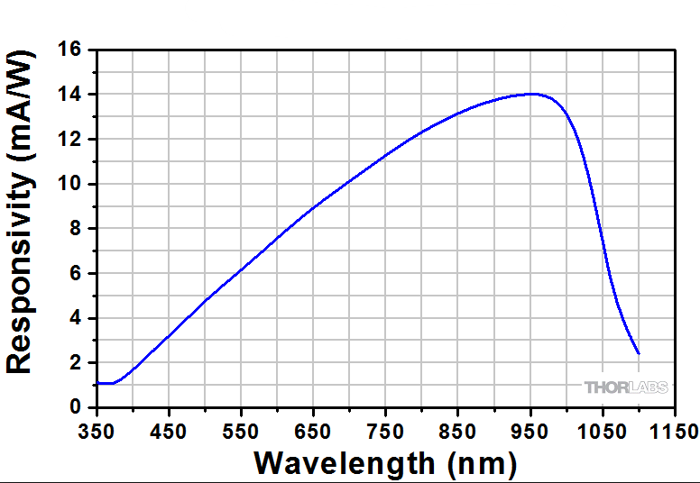
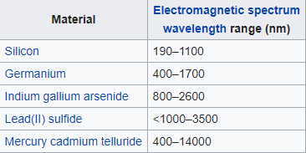
Receiver / Photodiode

Slide 11
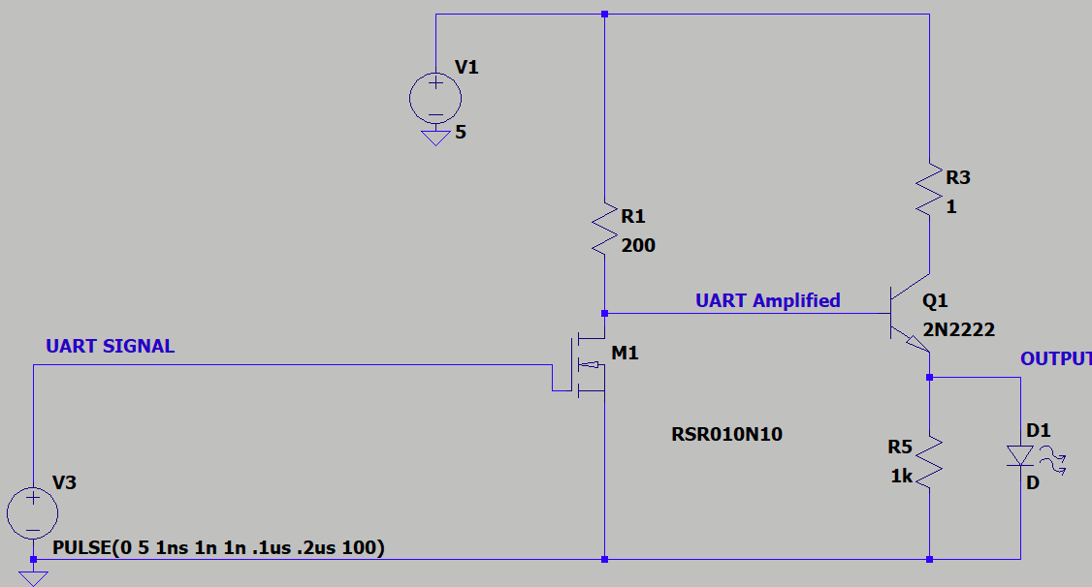
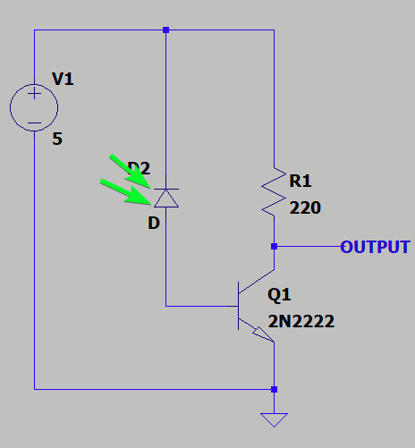
Power Amplifier and Signal Amplifier
Amplification ensures signal quality delivered to laser is not diluted
Two stage amplifier required Common/Emitter Source and Emitter Follower

Slide 12
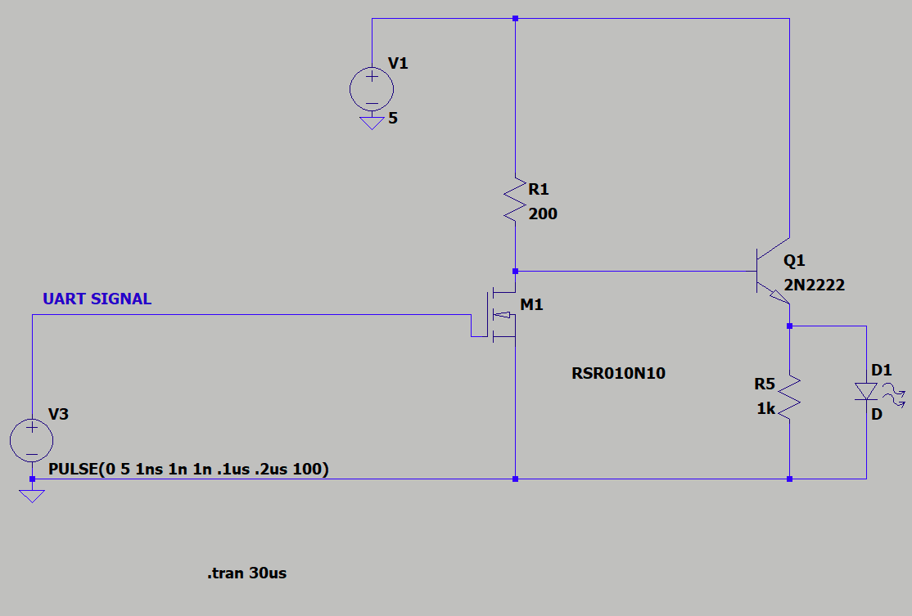
Common Source & Emitter Amplifier
This amplifies the voltage of the input signal
The output of the amplifier is inverted

Slide 13
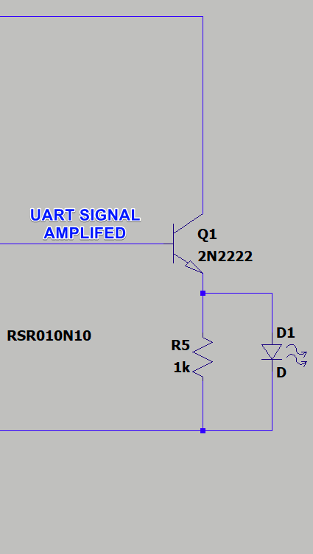
Emitter Follower Amplifier
The emitter voltage “follows” the base voltage
The base voltage is the output of CE amp

Slide 14
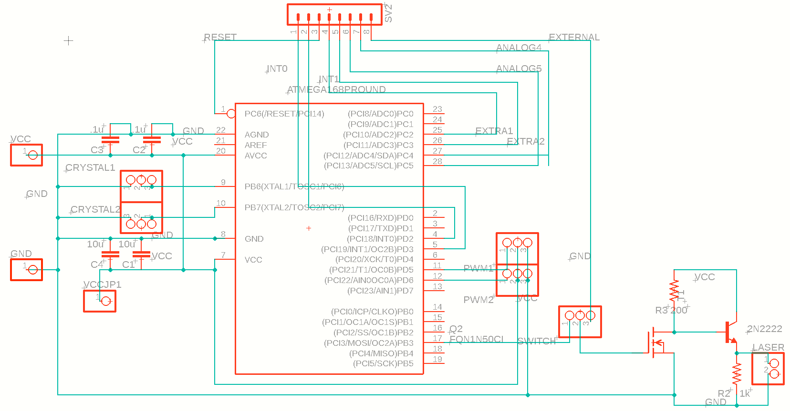
Transmission Schematic

Slide 15
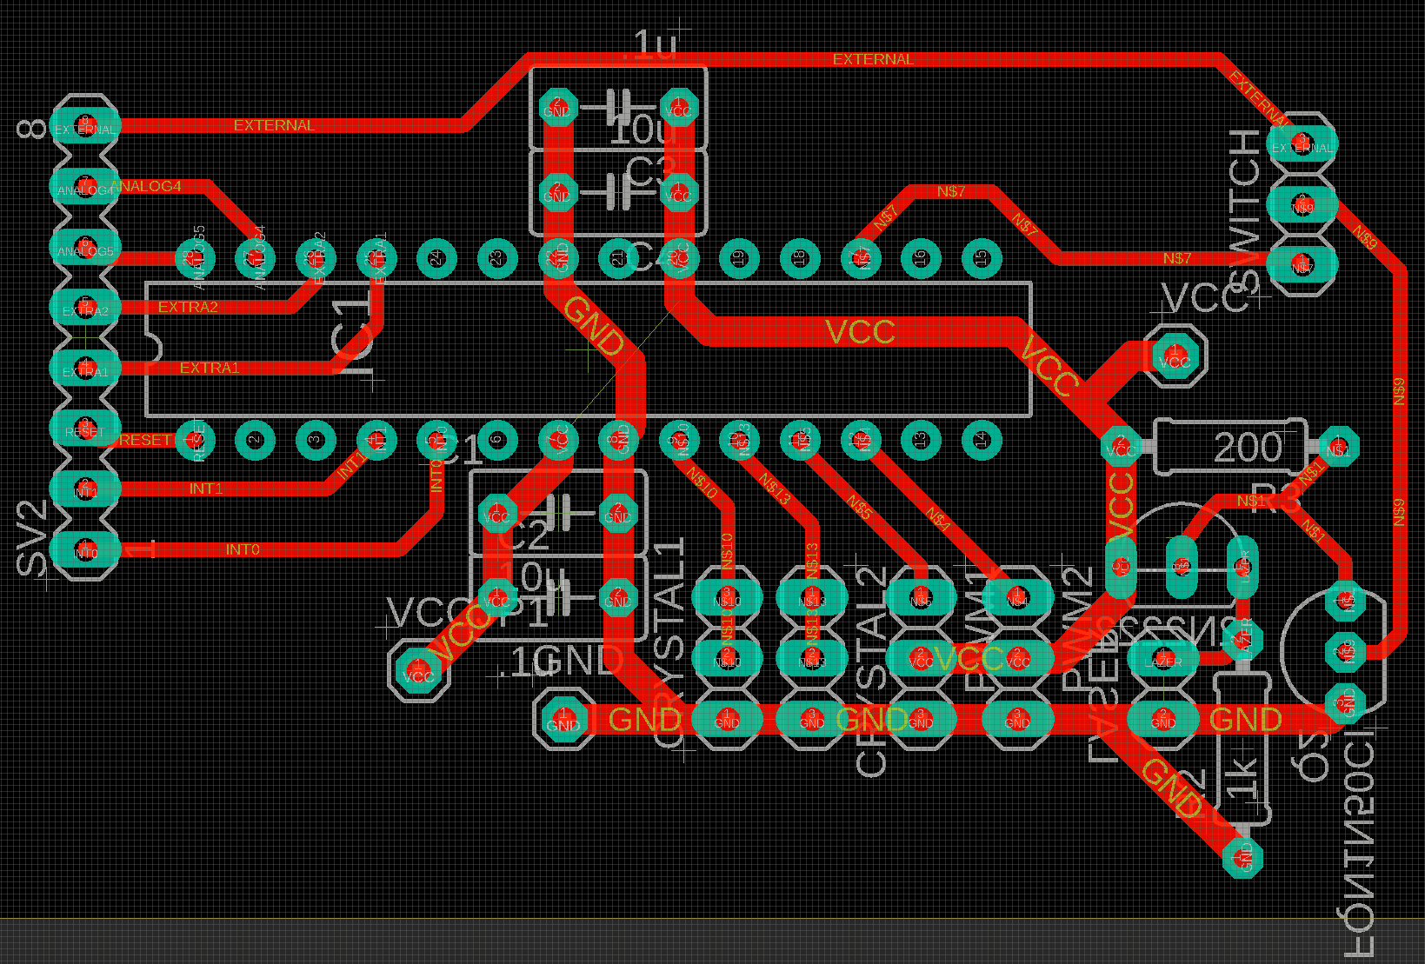
Transmission PCB Design

Slide 16
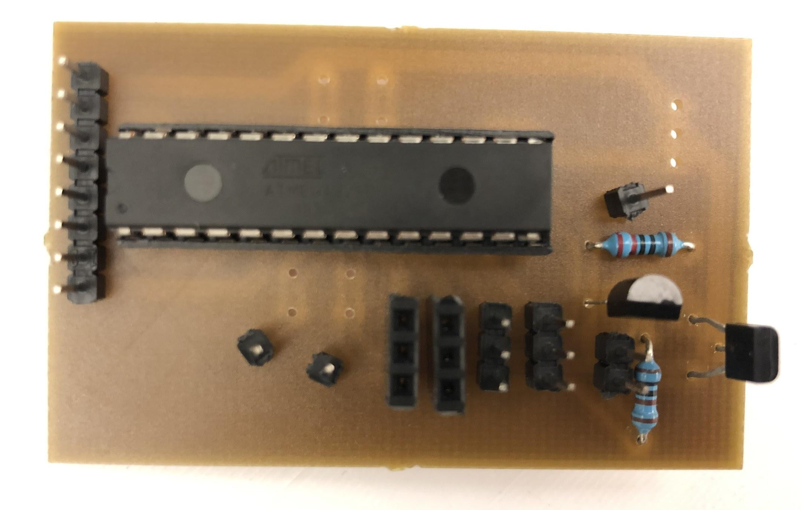
Transmission PCB

Slide 17
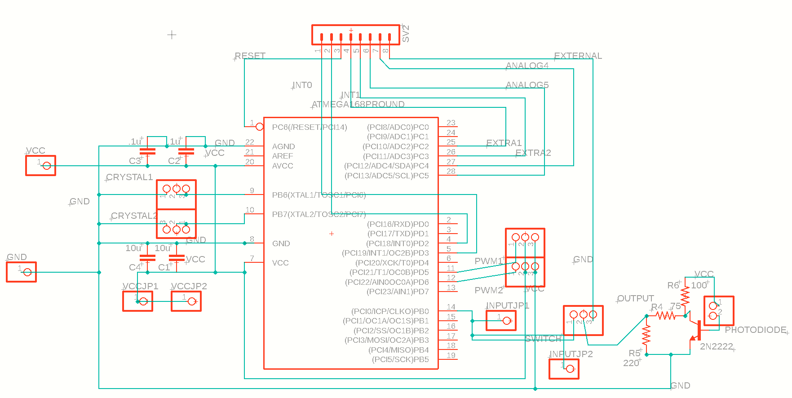
Receiver Schematic

Slide 18
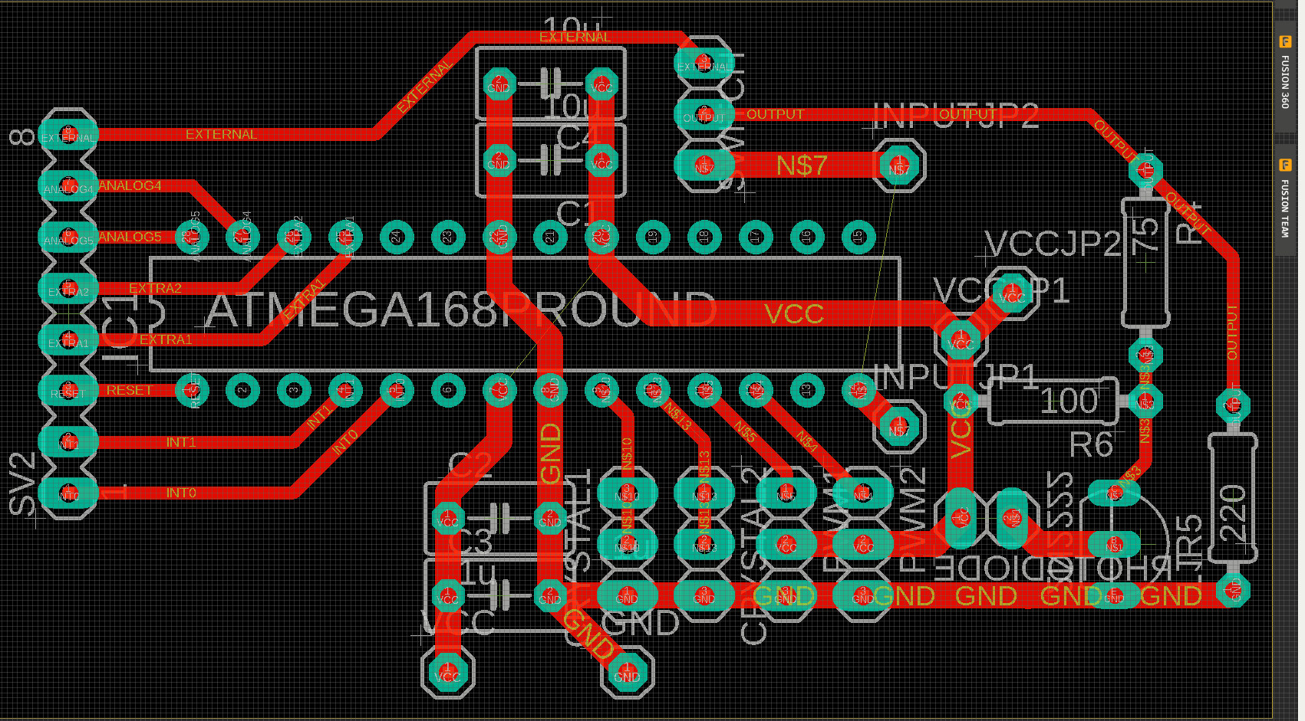
Receiver PCB Design

Slide 19
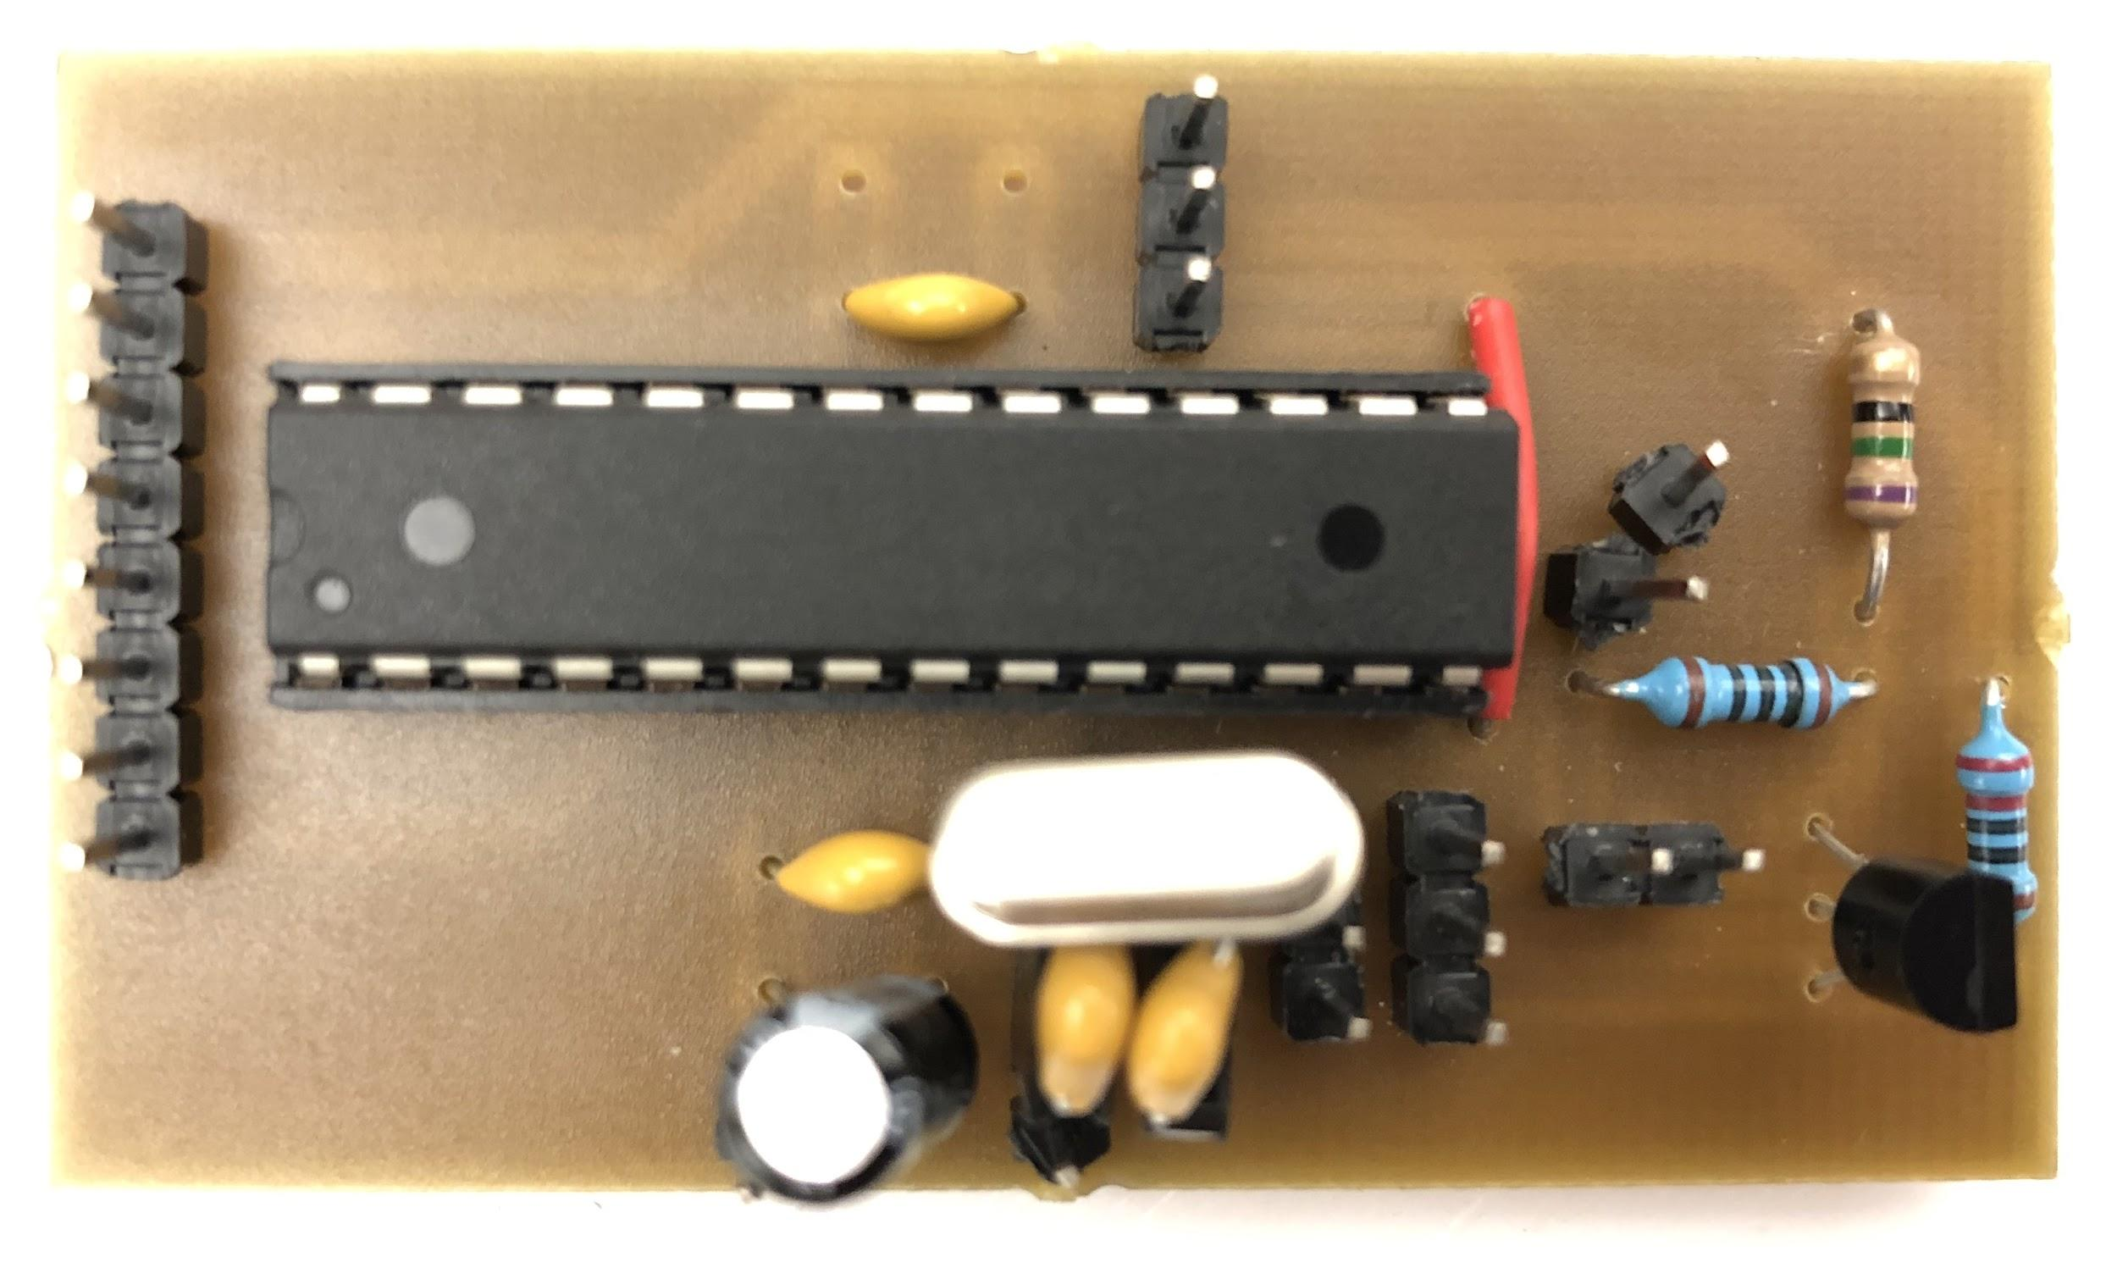
Receiver PCB

Slide 20
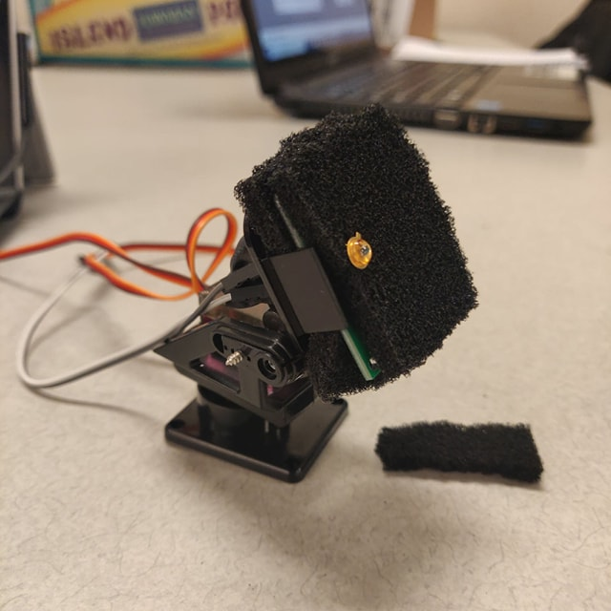
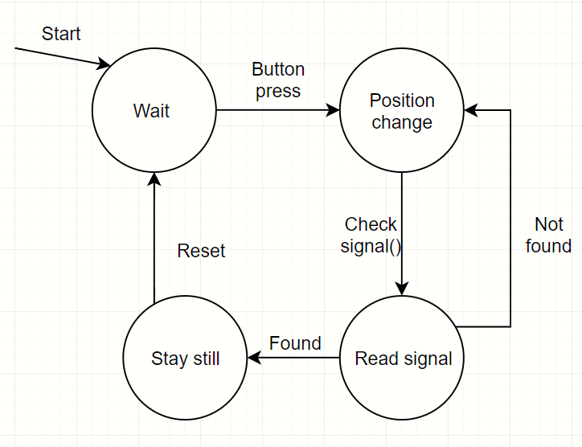
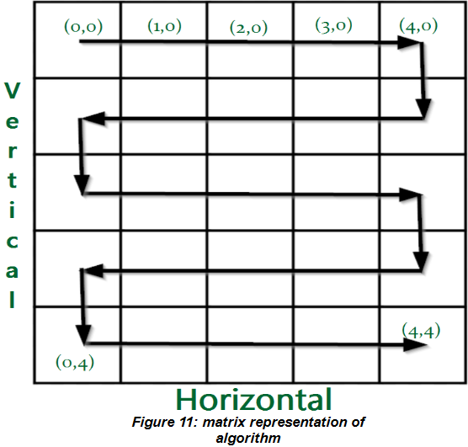
Automated Calibration
Search for signal
Check signal

Slide 21
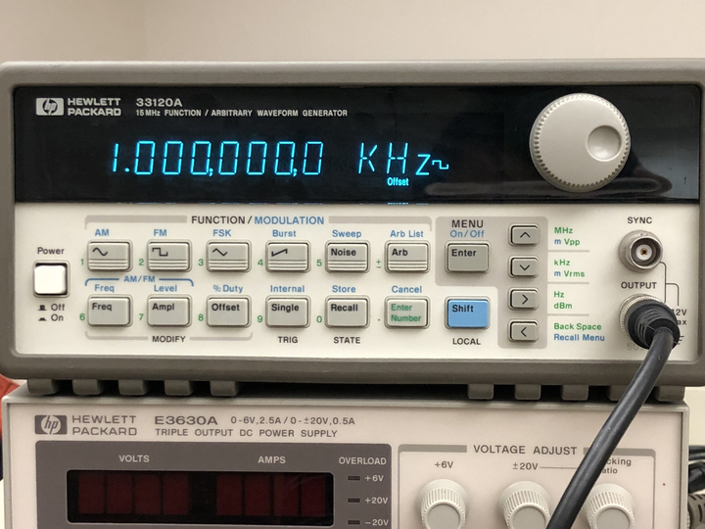
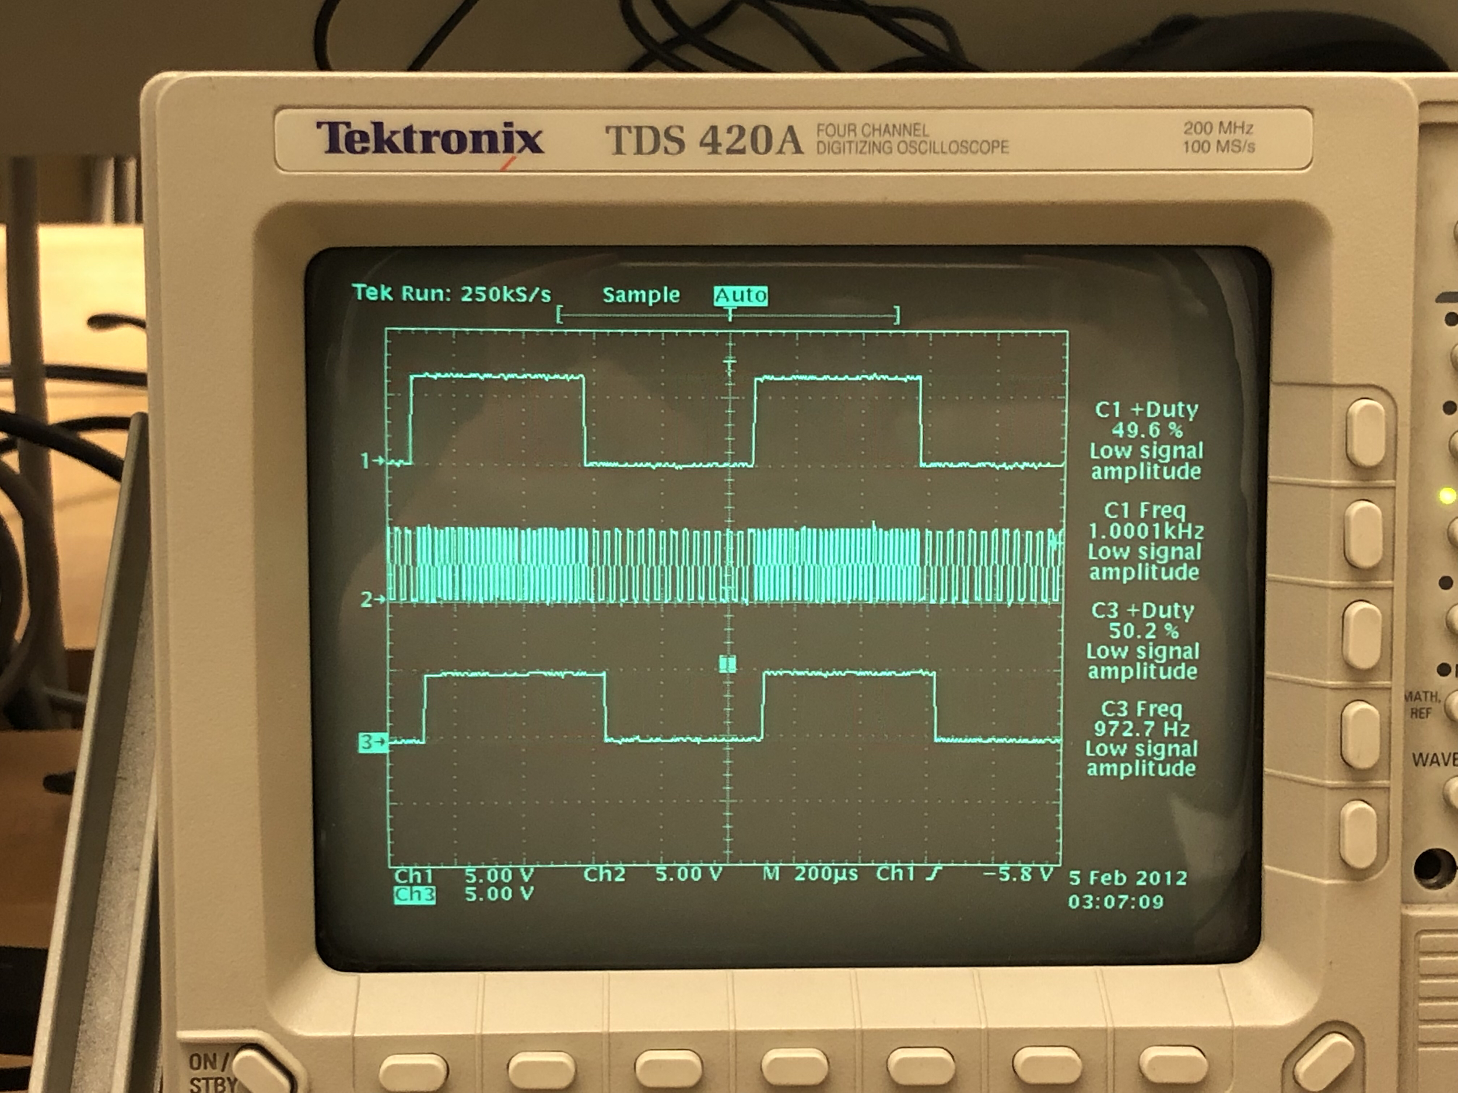
Frequency Modulation and Demodulation
Modulation:
0’s are represented by a low frequency
1’s are represented by a high frequency
Demodulation:
Converts modulated signal to be readable to MCU
High frequencies represent 1’s
Low frequencies represent 0’s

Slide 22
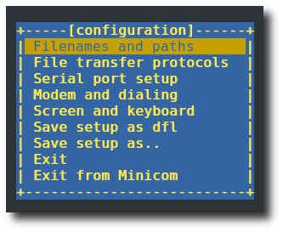
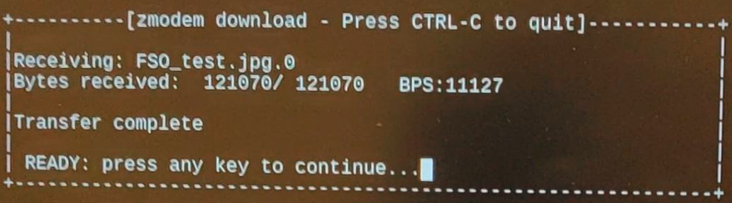
Data Protocol
Minicom is a text-based, serial communications program designed for Linux
Zmodem for file transfer protocol

Slide 23
Technical Challenges
Understanding how to pulse a UART signal with a laser diode and being able to read the signal with a photodiode
How photodiode is configured and how it can be read with an amplifier
Modulation for digital signals
Calibrating the alignment between the photodiode and laser diode

Slide 24
Design Considerations
Laser power, MCU clock speed (time sensitive task), photodiode responsivity/fall & rise time
Industry Standards
UART IEEE 1355-1995 Baud Rates: 2400, 4800, 9600, etc.
Performance
Baud rate performance
Max Distance (meters) | Max Baud Rate(no modulation) | Max Baud Rate(with modulation)
0.1 m (~ ½ a foot) | 500k baud | 4.8k
0.3 m (~ 1 foot) | 460k baud | 4.8k
2.44 m ( ~ 8 feet) | 230k baud | 2.4K

Slide 25
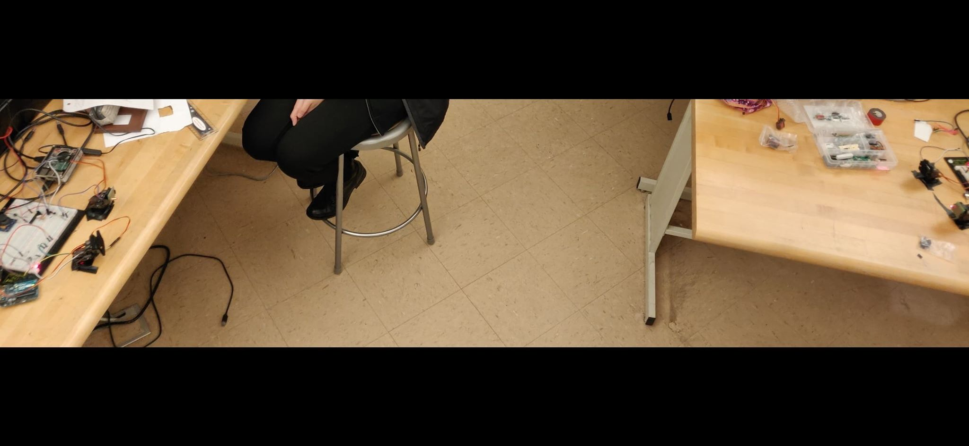
Test Report
System was tested by sending various images and files via file transfer protocol
Distances were varied to measure max baud rate

Slide 26
Video
Setup up:
https://www.youtube.com/watch?v=QCTVYBpL8-I&t=
Calibration:
https://www.youtube.com/watch?v=wU4sFGz83oo
Transmission:
https://www.youtube.com/watch?v=_QafSLDJa2Q

Slide 27
Summary
Max baud rate speed and distance exceeded expectations
Automated calibration has good accuracy at smaller distances
Kept system at 5 V
Future:
Increase max baud rate
Increase automated calibration accuracy at far distances
Different modulation & demodulation techniques
Acknowledges:
Roman Chomko
Manglai Zhou
Juan Gerardo Ruelas Jr.

